Slide 1
Weekly Review

Slide 2
Duolingo
Logan Danner – 50 days, Friend Quest
Mr. Smith – 500 days
Ms. Cayce, the Math Teacher – 500 days

Slide 3
Bonus Submissions
Jason Lara – Github Search
https://jlara2005.github.io/githubsearch/
Logan Cruz
Pokémon Apocalypse

Slide 4
Reflections
“I learned about cookies this week”
Yes, I know. What will YOU use them for?
Why not storing if the user chose “dark mode” for your site or not?
Parker Fink – “We spent way too much time in the meetings. Maybe pre-plan what needs to be discussed before meeting.”
Yes! Be prepared for any topic that may come up. Bring all relevant information. RESPECT EVERYONE’S TIME!
John Eckert – CIW Study method. Spent time with family.
Mac Hoover – VSCode technique. Study on the bus.
PLEASE CHECK YOUR REFLECTIONS FOR COMMENTS

Slide 5
My Reflection pt1
What is one technique thing you learned in coding teaching this week, and how will you use it in the future?
Write everything down. Instead of giving a lesson, give out a worksheet that can be kept as notes, THEN give a off-the-cuff lesson about that worksheet.
You’ll have the worksheet for next year. Even if you forget your Order of Study, you can piece it back together from all of the worksheets you did previously.
Students need multiple forms of engagement anyways, so you’re killing two birds with one stone.

Slide 6
My Reflection pt2
What was a challenge to your time management this week, and what can you do to avoid it in the future?
I just gave zero thought to when I was going to get my DocPacs graded. I’ve almost never left the school without the DocPacs in my backpack, but for some reason I just left without them.
Maybe I should start grading them in class on Friday and leave after they’re done. It worked in the past, but I can’t remember what else was happening that made it so effective that week.

Slide 7
My Reflection pt3
What opportunities did you NOT you take advantage of this week?
… … … … … …
I didn’t sell my Warhammer armies
I DID take pictures of random models I know I want to sell. About $500 worth.
I really want to play with my armies this week, but I should use my time listing the other stuff on eBay. The sooner I do, the sooner I can pay off the credit card I used for the new models. Interest on that card alone is about one box of Warhammer.
I’ve also ignored quite a few emails last week. I need to follow up with everything immediately.

Slide 8
This week / Loose Ends
5 people “passed” the Exam and would have been “certified”
If you missed it, schedule Intervention with me this week.
Grades are in Skyward
If your PR is in after Friday, you will need to contact me in writing telling me you submitted it late.
People will submit PR’s up to a week early. I don’t have time to sort through every PR all of the time.
Learn to differentiate between “talking about our project” and “BS”
If it can’t be said through Teams, it needs to be said quickly. You are preventing your team from working efficiently
DocPac tomorrow

Slide 9
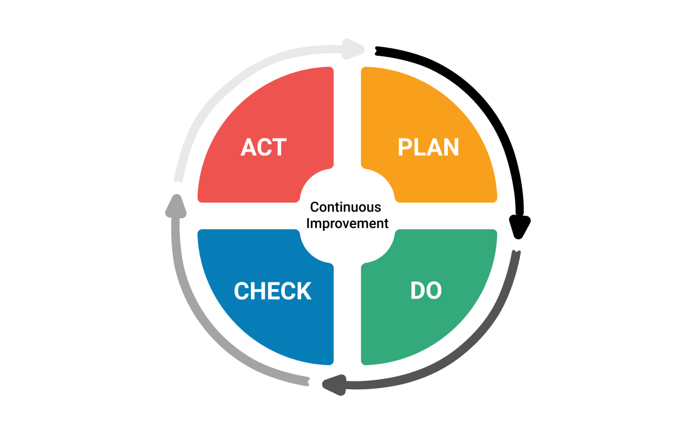
Continuous Improvement

